Slide 1
Image Captioning
簡介
Department of Computer Science, NCTU
TA Ziv(鍾嘉峻)

Slide 2
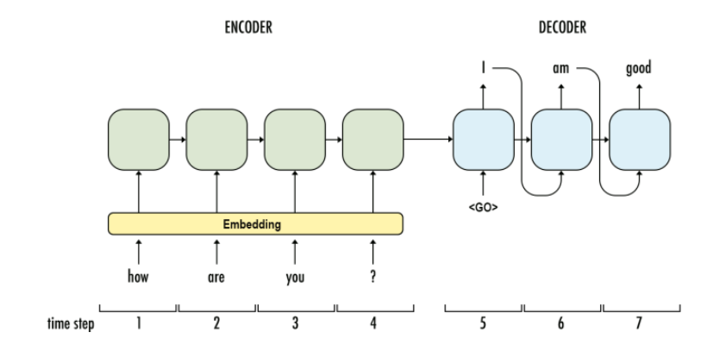
Encoder-Decoder

Slide 3
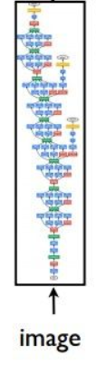
Encoder-Decoder
Show and Tell: A Neural Image Caption Generator

Slide 4

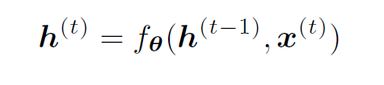
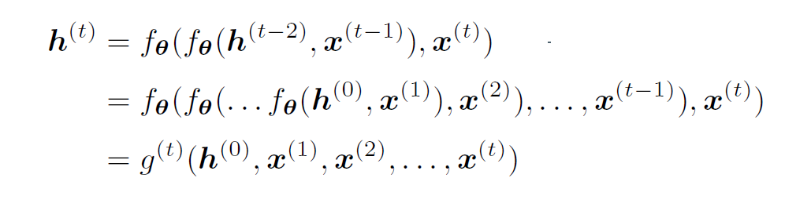
Sequence-to-Sequence
Basic RNN concepts:

Slide 5
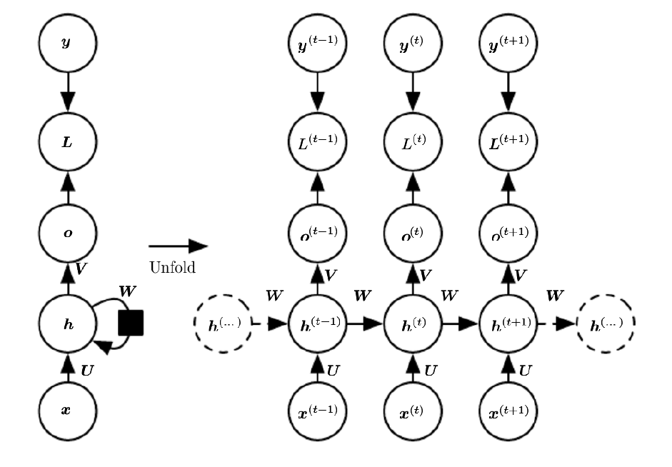

Slide 6

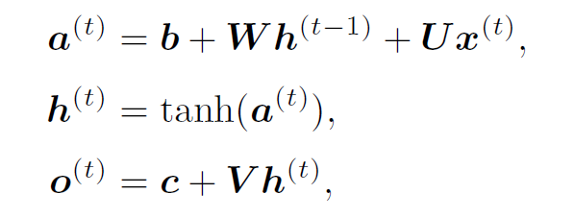
Sequence-to-Sequence
Basic RNN concepts:

Slide 7
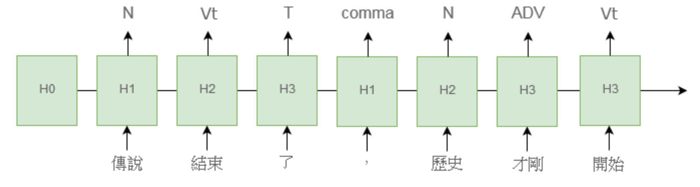
Basic RNN Application
Label a sentence

Slide 8
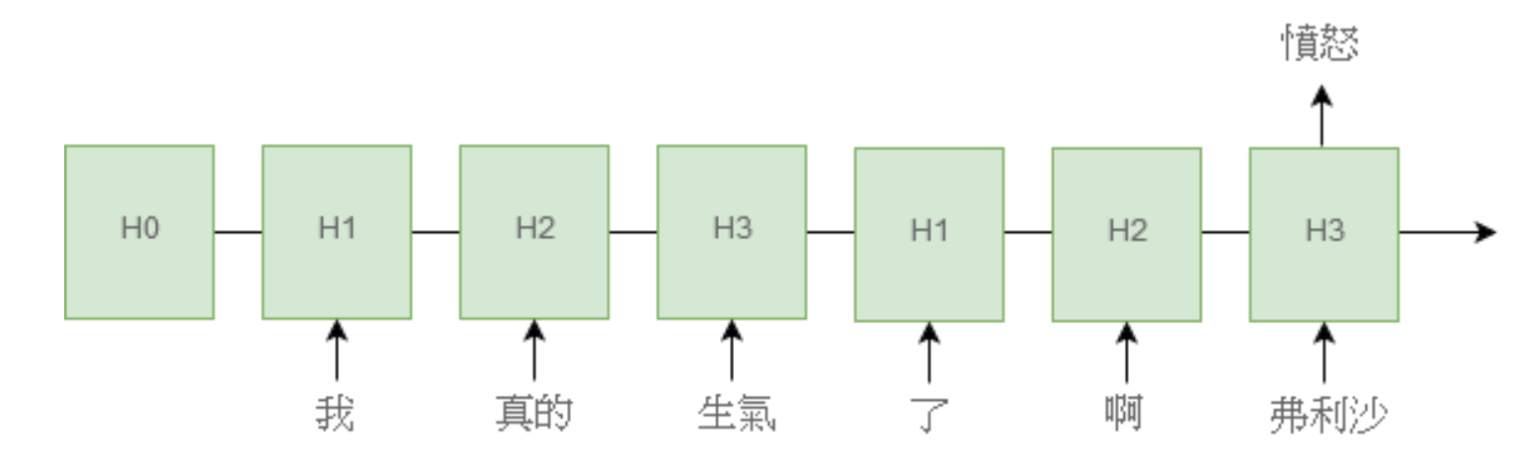
Basic RNN Application
Classification

Slide 9
Basic RNN Application
How about translator ?
Fine
English : How are you?
中文 : 你好嗎?
Same length!
Some …. trouble?
English : Elegance is the beauty that never fades.
中文 : 優雅是唯一不會褪色的美。
Different length QQQQQQQQ

Slide 10
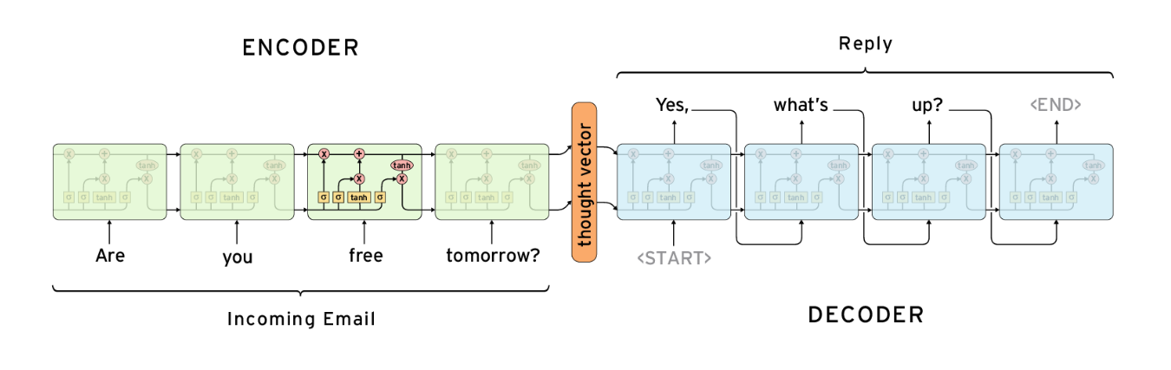
Sequence-to-Sequence
Use two RNN models

Slide 11
How about decoder??
We know that we can use a rnn as a encoder to encode something to a context vector
How about decoder??
We still have one input (a context vector) QQ
while True:
output = decoder(output)
outputs.append(output)

Slide 12
How about decoder??
Use “while” ??
When we stop??
Using a symbol to let this loop stop
We can use “EOS” (End Of Sentence)
while output != 'EOS':
output = decoder(output)
outputs.append(output)

Slide 13
Sentence-to-sentence
We use M-length as input and get 1 vector
We use this 1 vector as input and get N-length output
Appication?
Translator
Chat Bot
Summarizer
Poet
…..

Slide 14
Sentence-to-sentence
Can we use other architecture as “Encoder” ??
Not only use “RNN-based” architecture
Yes, of course XDDD
Or what is the lab3 for XDD

Slide 15
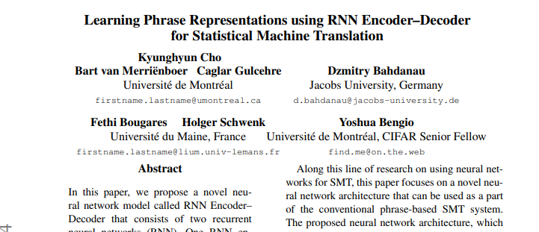
Paper Reference--Sequence-to-sequence
Learning Phrase Representations using RNN Encoder–Decoder for Statistical Machine Translation
https://arxiv.org/pdf/1406.1078.pdf

Slide 16
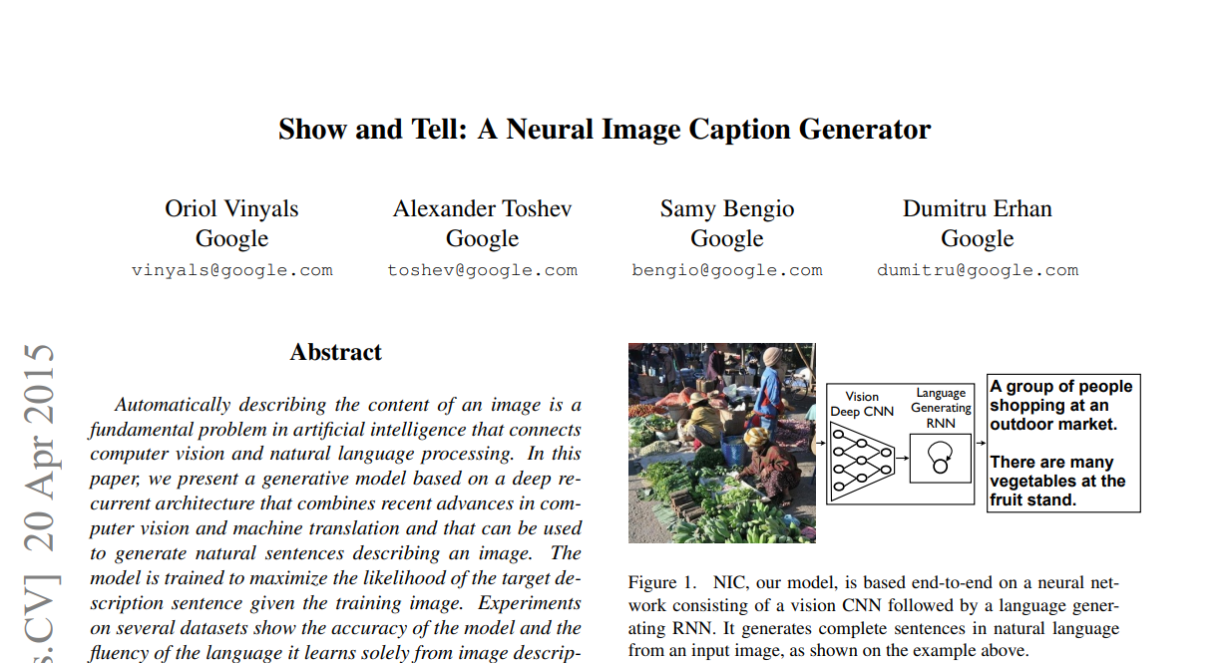
Paper Reference--Image Caption
Show and Tell: A Neural Image Caption Generator
https://arxiv.org/abs/1411.4555

Slide 17
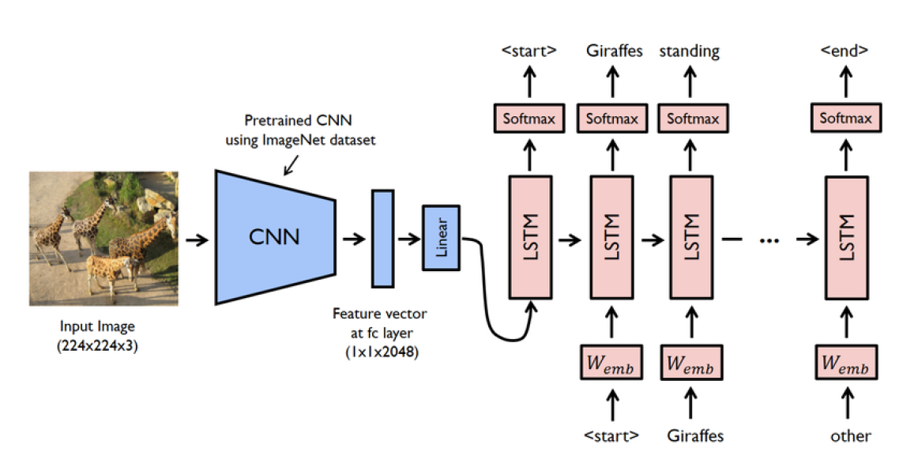
Image-Caption
Given a picture, tell me a story!

Slide 18
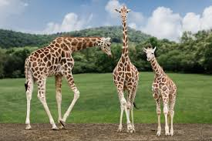
Simple Image Caption Problem
What’s wrong about simple “Image cation”
E.g We won’t “stare” at whole picture
We will pick up something and start to describe it

Slide 19
Simple Image Caption Problem
What’s wrong about simple “Image cation”
E.g We won’t “stare” at whole picture
We will pick up something and start to describe it
How we can improve ?
Use attention!!

Slide 20
Attention
The attention mechanism
Want model to paying attention to the salient information that should be focused on when generating a word.
The means is to give weight to each part of the input information.

Slide 21
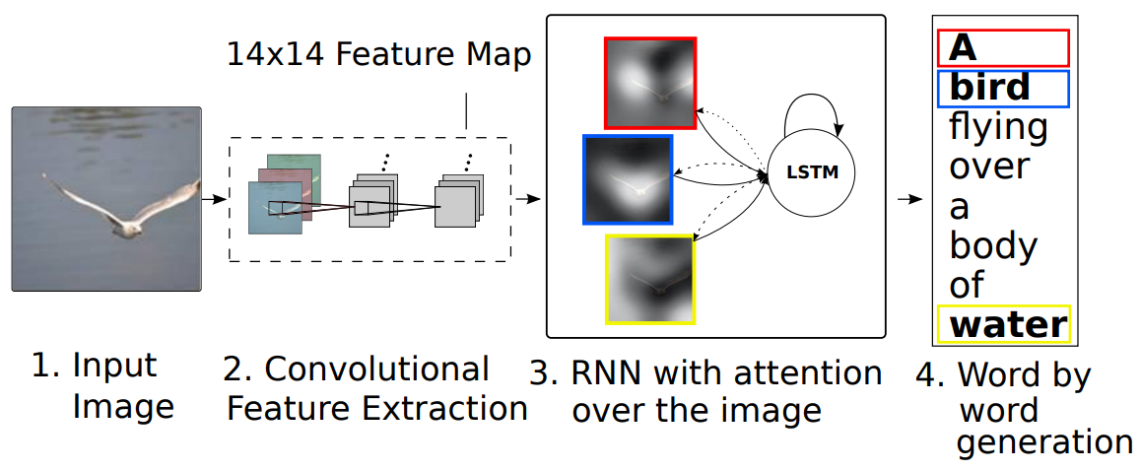
Image with Attention

Slide 22
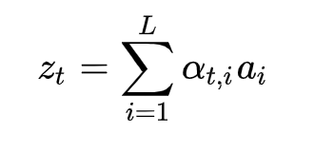
Image with Attention
Add Attention
Compute each area weight at each time “T”
E.g,

Slide 23

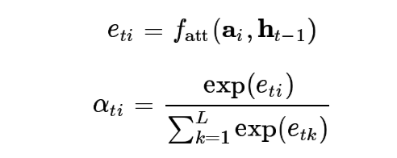
Image with Attention
Add Attention
Compute each area weight at each time “T”

Slide 24
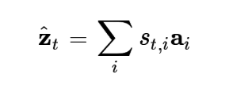
Hard Attention
Only one area will be choosed to send into decoder
S_t = 0 or 1

Slide 25
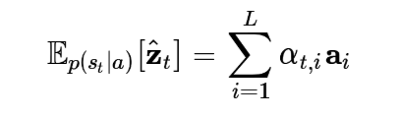
Soft Attention
Use weight to bring all area information into Decoder

Slide 26
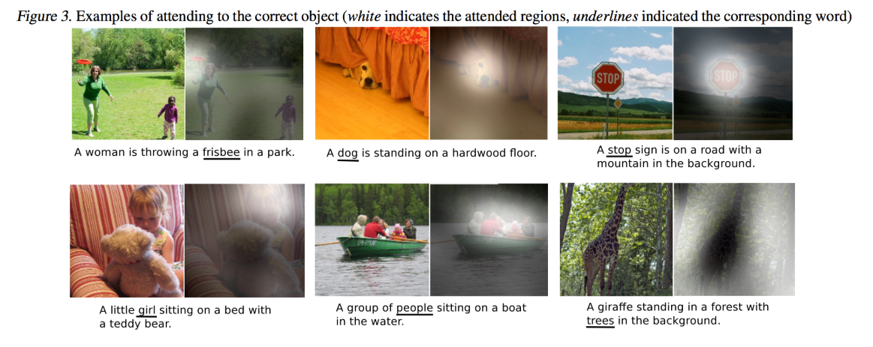
Result

Slide 27
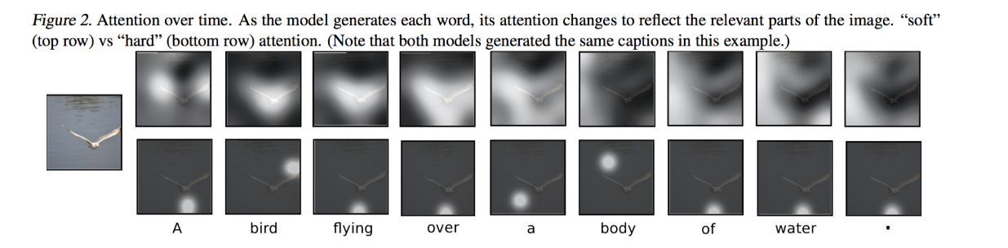
Result

Slide 28
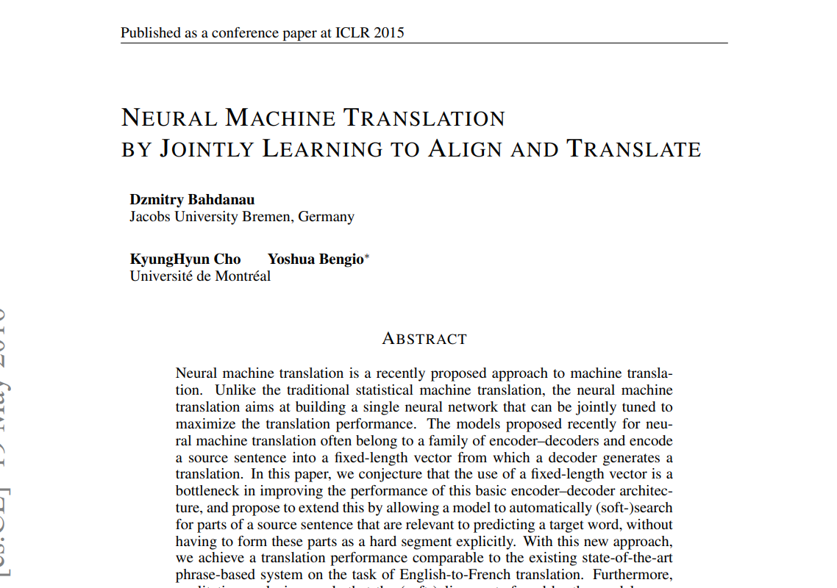
Paper Reference -- Attention
Neural Machine Translation by Jointly Learning to Align and Translate
https://arxiv.org/abs/1409.0473

Slide 29
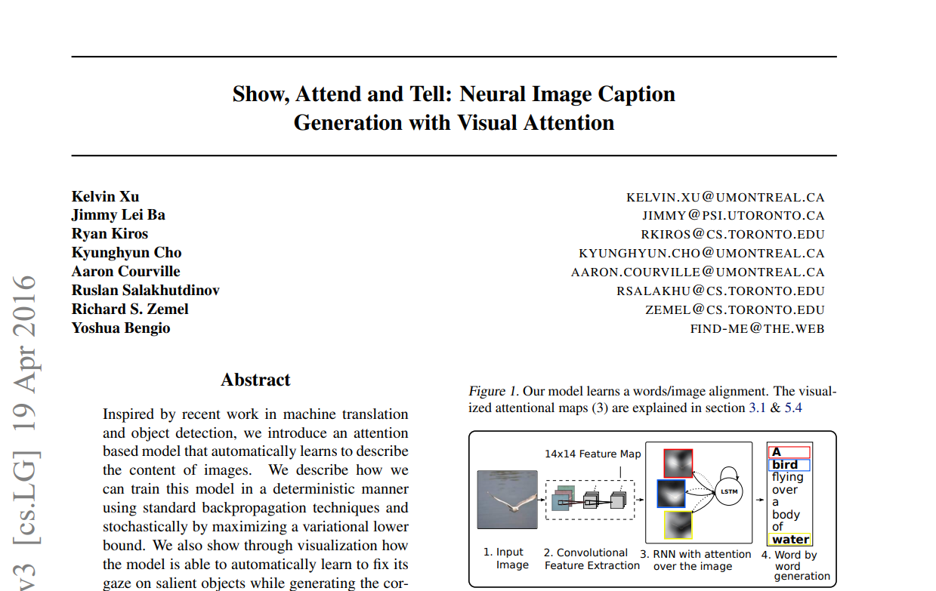
Paper Reference -- Image Caption with Attention
Show, Attend and Tell: Neural Image Caption Generation with Visual Attention
https://arxiv.org/pdf/1502.03044.pdf

